Slide 1

Mental Health
Alex Mariakakis
University of Toronto
Department of Computer Science

Slide 2
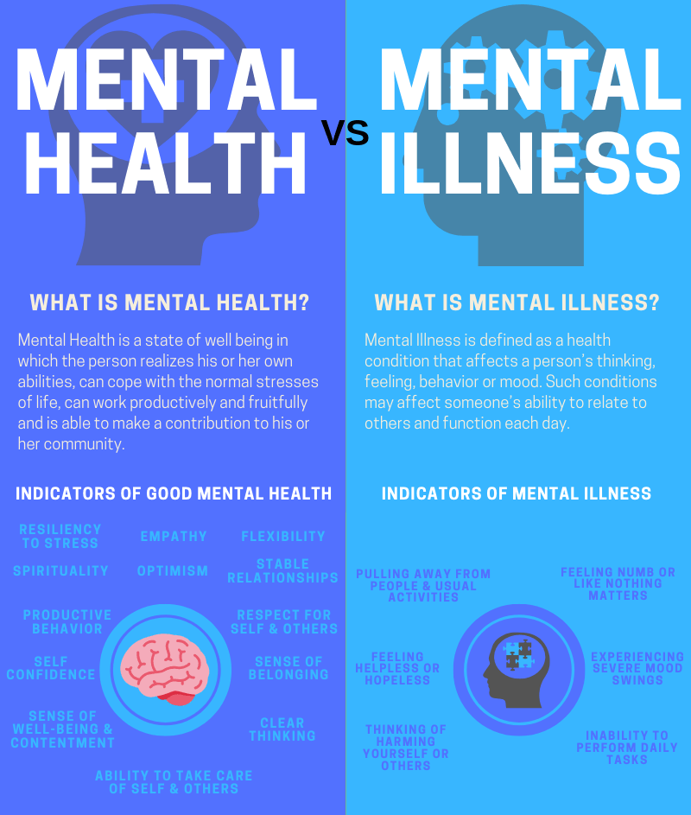
Mental Health ≠ Mental Illness
Mental health includes our ability to manage our emotions, cope with stress, maintain positive relationships, and function effectively in daily life
Mental illness refers to a range of conditions that affect a person's thinking, mood, behavior, and overall functioning
People can have poor mental health without having a mental illness

Slide 3
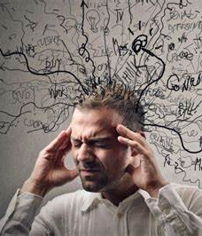
Mental Health
There are technically various forms of stress:
Physiological vs. psychological
Eustress (good) vs. distress (bad)
Acute (short-term) vs. chronic (long-term)
Can be influenced by our social, economic, geopolitical, and environmental circumstances

Slide 4
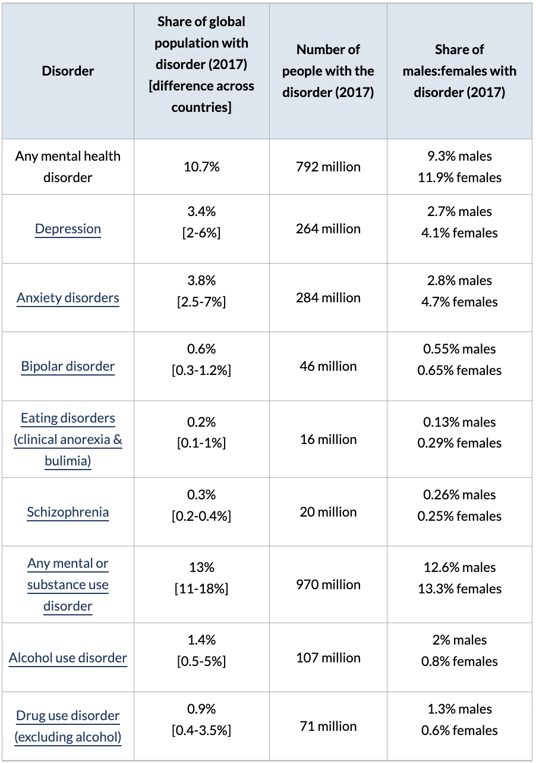
Mental Illness
In any given year, 1 in 5 people in Canada will personally experience a mental health problem or illness
Suicide is the second leading cause of death among youth and young adults between 15-34 years.

Slide 5
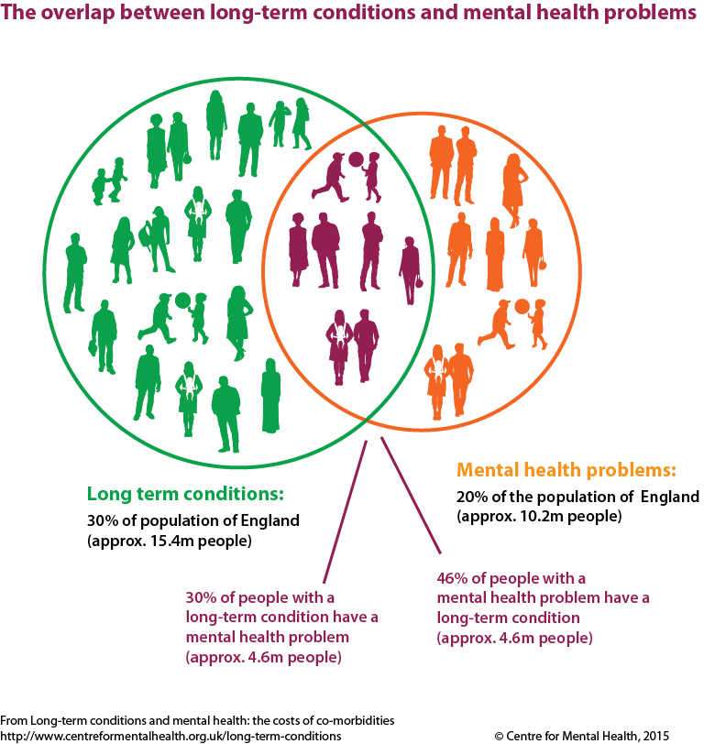
Physical Health ⇄ Mental Health
Physical Health → Mental Health
Chronic pain and disability can lead to depression, anxiety, and stress
Exercise has been shown to improve mental health
Mental Health → Physical Health
Anxiety and depression can lead to headaches, fatigue, and difficulty sleeping
Chronic stress can weaken the immune system

Slide 6
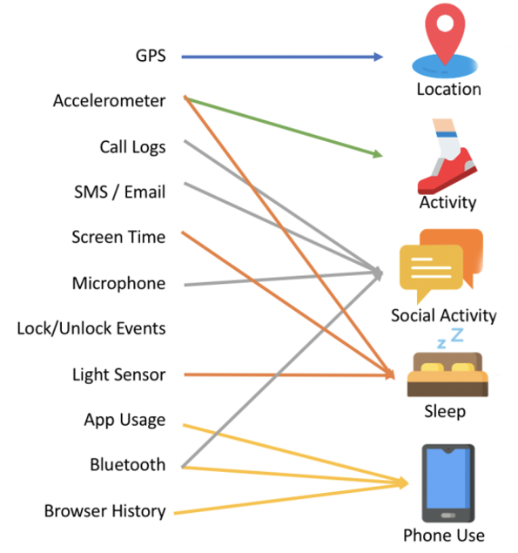
Where Does Mobile Health Come In?
Smartphones and wearable sensors can track behavioral and contextual features associated with mental health
Signal | Expected Trend Among Those With Depression
Location | Stay at home more often
Activity | Less active
Social Activity | Fewer social interactions
Sleep | More irregular, lower quality
Phone Use | More usage (implying more withdrawn)

Slide 7
Resources
Fast Facts about Mental Health and Mental Illness (Canadian Mental Health Association ‘21) Digital Phenotyping for Mental Health of College Students: a Clinical Review (Melcher et al. ’16)

